Slide 1
SECURE DATA HIDING IN IMAGES USING STEGANOGRAPHY
SECURE THE DATA TO PREVENT HACKERS
Presented By : AICTE- EDUNET FOUNDATION
Student Name : SAMMETA NAVYA SRI
College Name & Department : VASIREDDY VENKATADRI INSTITUTE OF TECHNOLOGY , ELECTRONICS AND COMMUNICATION ENGINEERING

Slide 2
OUTLINE
Problem Statement
Technology used
Wow factor
End users
Result
Conclusion
Git-hub Link
Future scope

Slide 3
Problem Statement
How to develop a steganographic system that allows for secure, robust, and imperceptible hiding of data within digital images, addressing the limitations of current basic implementations like limited capacity, weak security, lack of error handling, and platform dependency.

Slide 4
Technology used
Libraries:OpenCV : (Open Source Computer Vision Library) is a crucial library for the code you provided. It's the workhorse for handling the image-related tasks . This library is used for image processing, specifically reading and writing image files . Main functions are load images , Manipulates image pixels, saves the hiding data. OpenCV has a Image Reading , Image writing , pixel acsess which is essential for steganography
Platform:Python: The code is written in Python. You'll need a Python interpreter installed on your system to run it. To run Python code, you need a Python interpreter. This is a program that reads and executes your Python code. Python code runs on an operating system (like Windows, macOS, Linux). The OS provides the environment for the Python interpreter to work. While the core Python language is cross-platform (meaning the same Python code can often run on different OSs), there can be platform-specific dependencies..

Slide 5
Wow factors
Enhanced Security Measures:
Advanced Encryption Integration: Instead of just simple LSB modification, the project could incorporate robust cryptographic algorithms (like AES or RSA) before embedding the data. This adds an extra layer of security, making it much harder to retrieve the hidden message even if the steganography is detected. Steganalysis Resistance: The project could specifically target and address known steganalysis techniques. This could involve using techniques like: Minimizing Statistical Anomalies: Algorithms that carefully analyze and adjust pixel changes to avoid statistical detection.
Adaptive Embedding: Dynamically altering the embedding process based on the image content to make detection more difficult.
Optimized Embedding Algorithms: Developing new or improved algorithms that can hide more data without significantly affecting image quality. This could involve exploring more complex pixel manipulation techniques or using transform domains more effectively.
Compression Techniques: Compressing the message before embedding it can allow for hiding larger amounts of data.
Parallel Processing: Utilizing parallel processing or GPU acceleration to speed up the embedding and extraction processes, making the steganography more practical for large files or real-time applications.

Slide 6
End users
Organizations and businesses:
Corporations: To protect trade secrets, intellectual property, and confidential business information.
Government agencies: For secure communication and covert operations.
Law enforcement: For investigations and evidence gathering.
Healthcare providers: To secure patient data and medical records.
Financial institutions: To protect sensitive financial information.
Researchers and developers:
Security researchers: To study and improve steganographic techniques.
Software developers: To integrate steganography into other applications.
Privacy-conscious individuals: For personal communication or storing sensitive data.

Slide 7
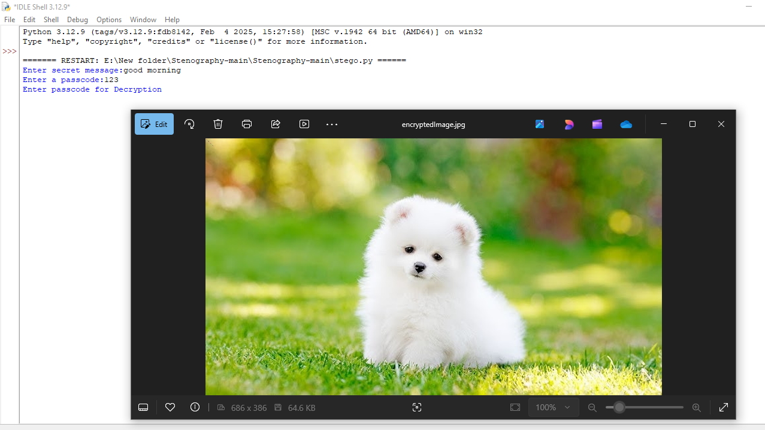
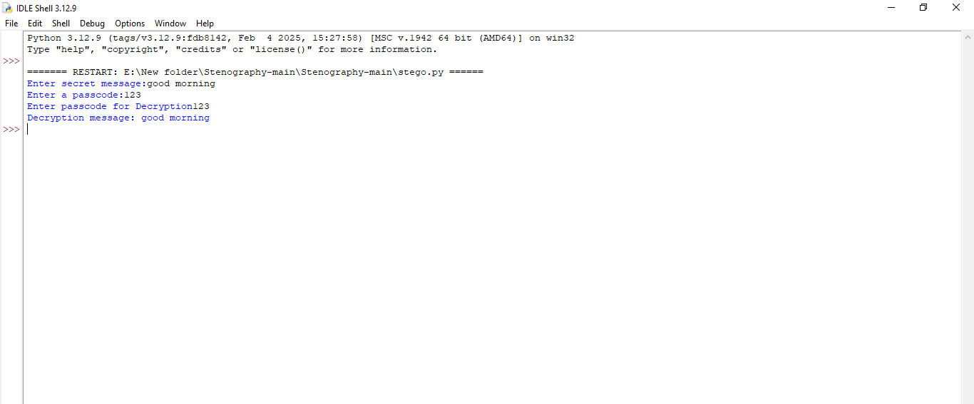
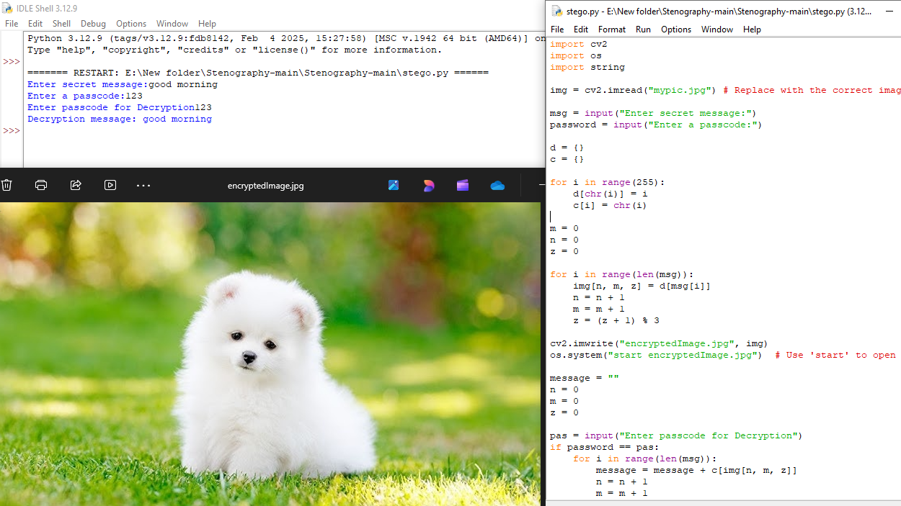
Results

Slide 8
Conclusion
This project successfully demonstrated the implementation of a secure data hiding system that leverages the strengths of both steganography and public-key cryptography. By encrypting the data with a public key before embedding it within the image using steganographic techniques, we have significantly enhanced the security of the hidden information. This approach addresses the vulnerability of relying solely on the obscurity of steganography by adding a layer of cryptographic protection. Even if the steganographic method is compromised, the encrypted data remains confidential, requiring the corresponding private key for decryption. This combined approach offers a more robust solution for secure data hiding, suitable for applications where confidentiality and undetectability are both critical. Future work could explore optimizing the encryption and embedding processes for improved performance and investigating methods to further enhance resistance against advanced steganalysis techniques.

Slide 9
GitHub Link
https://github.com/Navyasrisamme02/secure-data-hiding-in-images-using-steganography.git

Slide 10
Future scope(optional)
Advanced Steganalysis Countermeasures: Research and implement strategies to defend against increasingly sophisticated steganalysis attacks, including deep learning-based methods. This could involve exploring techniques like generative adversarial networks (GANs) for steganography or developing methods to detect and neutralize steganalysis attempts.
Adaptive Steganography: Develop algorithms that dynamically adjust the embedding process based on the image content and potential attack vectors. This would involve analyzing the image to identify regions less susceptible to detection and adapting the embedding strategy accordingly.
Multi-layered Security: Explore combining steganography with other security mechanisms, such as digital watermarking or blockchain technology, to create a more comprehensive security framework.

Slide 11
THANK YOU

